Slide 1
Columbia Asia Hospital Project
- R. Mohanakanna

Slide 2
Introduction
Hospitals face staff shortages, high costs, and COVID-19 challenges while striving for better care and efficiency.
Invest in staff training, control costs, prioritize safety, leverage technology, and enhance patient access for improvement.
Analyze patient satisfaction scores to pinpoint areas of improvement.
Assess wait times and appointment scheduling to enhance access to healthcare services.
Evaluate demographic data to tailor services and outreach efforts effectively.
Implement measures to reduce patient wait times and streamline processes

Slide 3
Objectives
To understand the hospital growth both in financial and social terms.
Identify the domains to be focused to improve the patient satisfactions.
Introducing strategies to increase the patients visit and maintaining the standards without seperating patients by their demographics.
To identify average waiting time, frequency of visit by demographics.
To identify domains to hire doctors and to offer discounts

Slide 4
Data Overview
Date: This column contains date and time information without specifying AM or PM. The format is DD-MM-YYYY HH:MM.
Patient ID: Each patient is assigned a unique identifier, which seems to be in the format 124-62-3289.
Patient Gender: This column records the gender of the patient, denoted by 'M' for male and 'F' for female.
Patient Age: The age of the patients is listed in years.
Patient Sat Score: It seems to represent a satisfaction score given by or for the patient. However, the scores are single-digit, and it's not clear what the scale is.
Patient First Initial: This column contains the first initial of the patient's first name.
Patient Last Name: The surname of the patient is listed in this column

Slide 5
Data Overview Contd.
Patient Race: The racial or ethnic background of the patient is recorded here, with categories such as 'White', 'African American', 'Asian', 'Native American/Alaska Native', and 'Two or More Races'.
Patient Admin Flag: This column contains boolean values ('TRUE' or 'FALSE') which might indicate whether the patient was admitted or some other administrative flag.
Patient Wait Time: Appears to indicate the time the patient waited, possibly in minutes, before being seen or processed.
Department Referral: This column lists the department to which the patient was referred, with entries such as 'General Practice', 'Orthopedics', 'Gastroenterology', or 'None' indicating no referral.
Doctor Name: Identifies the doctor who attended each patient.
Appointment Fees: The cost charged for a doctor's consultation.
Total Bill: The overall amount billed to the patient, including all services and charges.

Slide 6
Methodology
  Data Cleaning: Removed duplicates, handled missing values, and standardized formats using Power Query Editor.
  Data Enrichment: Joined datasets to enable comprehensive analysis.
  Measure Creation: Developed DAX measures for key performance indicators.
  Visualization: Created various visualizations for presenting insights
  Specific DAX Functions:
Dax Functions | Measures
Average | Satisfaction score, patient wait time
Switch | Age group
Previousmonth | Previous month visits
Sumx | Revenue
Calculate, Maxx | High fees Department
Calculate, countx | Patients by particular doctors

Slide 7
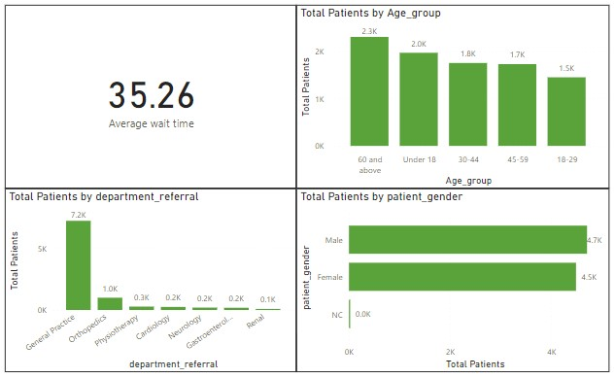
Analysis of Objective Questions
On average patient spend 35.26 min before receiving care
Most frequently visited department is General Practice which accounted for 78.56% of Total Patients.
Patients in the age group of 60 and above utilize the healthcare the most and patients in the middle age(19-30) are least which have difference of 58.88%
Male and female are almost equally visited the hospital.
Figure:1

Slide 8
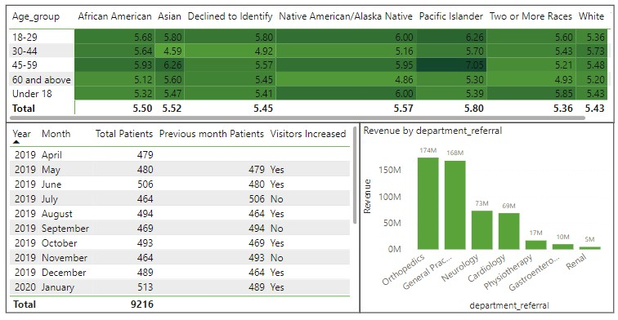
Analysis of Objective Questions Contd.
Analyze demographics; older age groups less satisfied ;target improvement efforts.
Orthopedics has the highest revenue contributes 33.78% to the total revenue.
Patient visits mostly increased compared to the previous month
Figure:2

Slide 9
Analysis of Objective Questions Contd.
Department with highest appointment fees is Neurology. | CALCULATE(MAXX(Sheet1,Sheet1[department_referral]),Sheet1[Appointment Fees]=MAX(Sheet1[Appointment Fees]))
5986 patients were attended by Dr. Smith. | CALCULATE(COUNTX(Sheet1,Sheet1[patient_id]),Sheet1[Doctor Name]="Dr. Smith")
Average age of patient who visit Orthopedics department is 39. Yes the approach will change if we want to calculate this metric for all departments. | CALCULATE(ROUND(AVERAGEX('Hospital ER','Hospital ER'[patient_age]),0),'Hospital ER'[department_referral]="Orthopedics")

Slide 10
Analysis of Objective Questions Contd.
When the dataset has null values the following steps can be suggested:
  Replace Nulls with defaults using IF or ISBLANK functions.
  Filter out null values using Power BI's filter capabilities.
  Handle null values in data source using SQL or ETL processes.
  Use default values for nulls in data model or calculations.
  Consider context, treat nulls appropriately, adjust calculations or exclude them

Slide 11
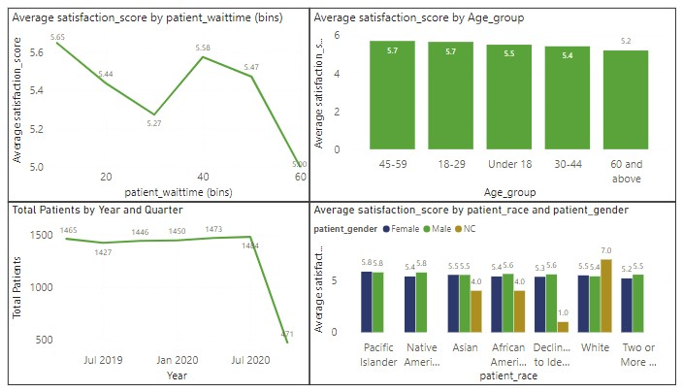
Insights from Subjective Questions
Decreasing wait time tends to lower patient satisfaction scores.
Annual patient visits rise, but quarterly, a sharp decline occurs at the last quarter from 1484 to 471 patients.
Highest satisfaction: age group 45-59; lowest: age group 60 and above.
Average Satisfaction scores (4.77-5.33) show no demographic-based discrimination in patient care analysis.
Figure:3

Slide 12
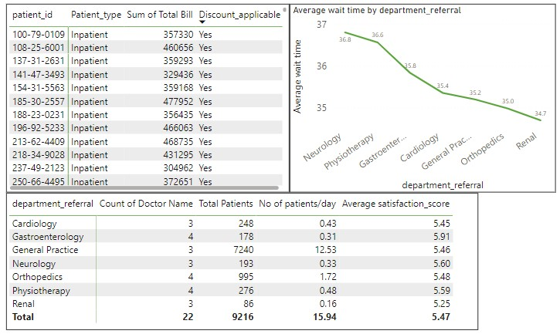
Insights from Subjective Questions Contd.
Different discounts are provided to patients based on their type, total bill, and department, with extra consideration for inpatients' financial urgency and critical condition.
High visit and low satisfaction department like General Practice, Orthopedics and Physiotheraphy needs more doctors.
There are no departments for which the waiting time is oddly large.
Figure:4

Slide 13
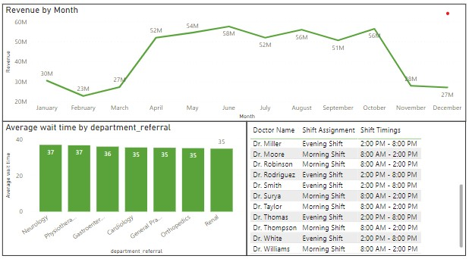
Insights from Subjective Questions Contd.
The hospital is not profitable. Analysing quarter wise average Revenue generated droped from 81M to 68M.
Consistently average waiting time is 35-37 min across all departments.
Doctors are assigned to two shift timings which will cover majority of the patients and increase patient satisfaction.
Figure:5

Slide 14
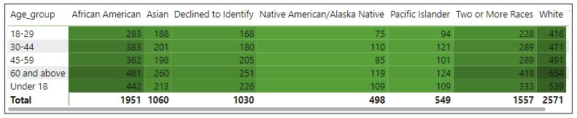
Insights from Subjective Questions Contd.
Demographic analysis shows Pacific Islander and Native American/Alaska Native visit less.
Figure:6

Slide 15
Insights from Subjective Questions Contd.
PowerBI Gateway:
It enables secure data transfer between Power BI and on-premises data sources, facilitating real-time analytics, scheduled refreshes, and access control, ensuring data accuracy and compliance.
Strategies to provid discount to patients:
Offer discounts for returning patients,Provide discounts based on income or insurance coverage,Offer reduced rates for multiple visits or treatments.Charity Care: Provide discounts or free services for financially disadvantaged patients.

Slide 16
Strategic Recommendations
Analyze satisfaction scores by department to identify doctor needs and shift timings.
If hospital hire new doctors in required departments,the waiting time get reduced and the satisfaction score increased.
` By implementing shift timings can boost the doctor’s efficiency.
Offer discounts to emergency patients to boost revenue and satisfaction.
If hospital offer discount, then the loyal customers will increase which automatically increase and total and frequency of visit.
Demographics analysis shows no discrimination on patients by their age,race and gender which will increase the hospital popularity.

Slide 17
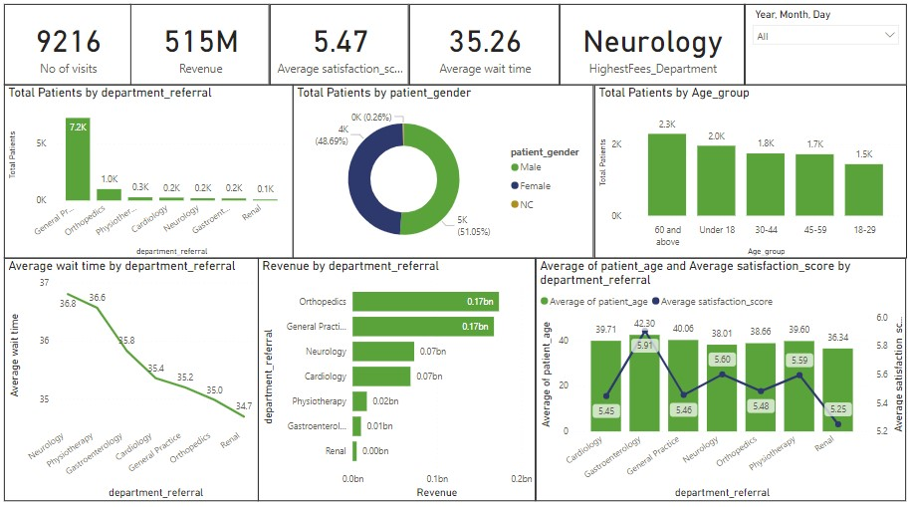
Main tab
Using this tab patients frequency to departments, revenue, average satisfaction and waiting time on a particular and range of date can be analyzed.

Slide 18
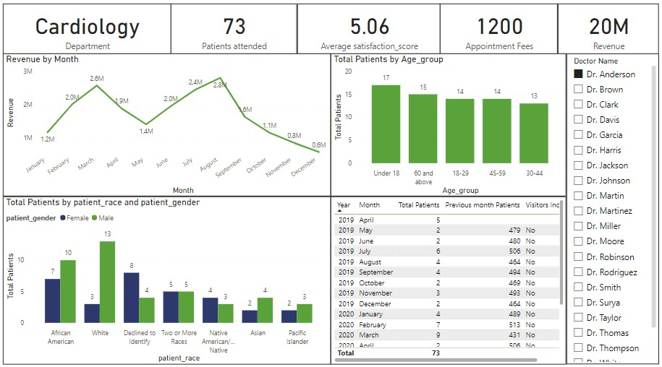
Doctor’s tab
By this tab about doctor’s work in the hospital can be found like department, no of patients treated, fees etc…

Slide 19
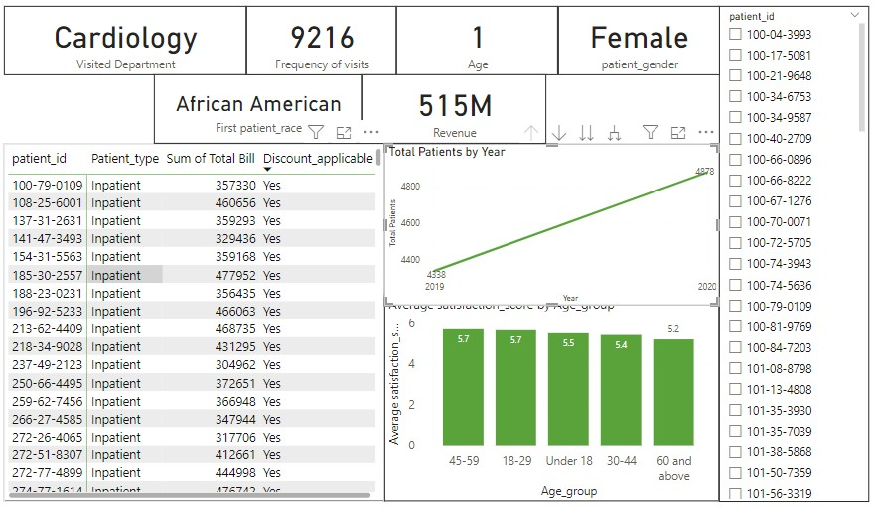
Patient’s tab
In this tab patient’s details like name, age, gender, visited department etc. can be found using patient_id.

Slide 20
Conclusion
Tailoring services and marketing efforts based on visitor demographics enhances patient engagement.
Analyzing visitor numbers and gender helps devise inclusive healthcare strategies.
Revenue analysis informs resource allocation across departments for efficiency.
Tracking visitor numbers aids in forecasting demand and optimizing staffing.
Implementing targeted discounts and adjusting doctor shifts enhances satisfaction and operational efficiency

Slide 21
References
Columbia Asia Hospital Project

